Slide 1
Optimized Traffic Flow at a Single Urban Crossroads: Dynamical Symmetry Breaking
M. Ebrahim Fouladvand ,Nima Hamedani Radja
Technical Report: IPM/P-2001/039,
Institute for Studies in Theoretical Physics and Mathematics (IPM)
Presenter: Shiuan-Wen Chen
Date: Oct. 19, 2006

Slide 2
ABSTRACT
We propose a stochastic model for the intersection of two urban streets. The traffic state at the crossroads is controlled by a set of traffic lights which periodically switch to red and green with a total period of T. Vehicular dynamics is simulated and total delay experienced by the traffic is evaluated within a definite time interval. Minimising the delay give rises to the optimum signalisation of traffic lights. It is shown that two different traffic phases are identified in the symmetrically loaded crossroads. In the light traffic phase, the green times should be divided to the streets on an equal basis. In the congested phase, Minimising the delay enforces us to break the symmetry between the roads by allocating the majority of green time to one of the roads. In contrast to common sense, equally dividing the green times to the roads, leads to unfairness to drivers.

Slide 3
I. INTRODUCTION
Recently, discrete models such as cellular automata have provided a significant theoretical framework for modelling traffic flow.
The first cellular automata was introduced by Biham, Middleton and Levine.
Isolated crossings are fundamental operating units of the sophisticated and correlated urban network and thorough analysis of them would be advantageous toward the ultimate task of the global optimisation of the city network.

Slide 4
I. INTRODUCTION
There are two basic types of control for traffic lights at intersections: fixed-cycle and traffic-responsive.
Both of these methods can be implemented via centralized or decentralized strategies.
In this paper we study the impact of randomness in vehicular demand at a single crossroads which is controlled under a decentralized fixed-cycle scheme.

Slide 5
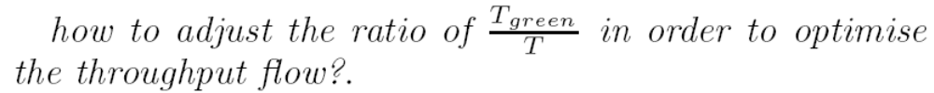
II. FORMULATION OF THE MODEL
Here for simplicity we restrict ourselves to the simplest structure of a crossroads: a one-way to one-way intersection.
The basic question is
traffic is controlled by a fixed-cycle
scheme.
Cycle: T
0 ~ T_{green} ~ T
Street B
g
g
Street A

Slide 6
A. Vehicular dynamics at the crossroads
Our crossroads is modelled by a set of two perpendicular chains.
At each step of time, the system is characterized by the vehicular configuration at each road and the traffic light state of road A (north-bound vehicles).
L
:a typical car length
L

Slide 7
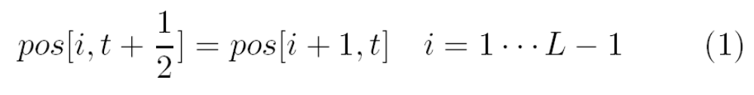
A. Vehicular dynamics at the crossroads
The state of the system at time t + 1 is updated from that in time t by applying the following rules.
If the remainder of division of t + 1 by T is less than
T_{green}, then the signal state is defined as being green
for street A and red for street B.
1
the velocities of all cars are taken to be equal.
L-1

Slide 8
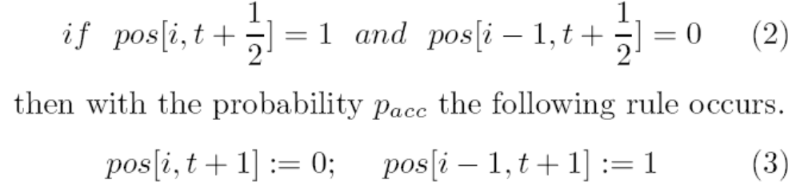
A. Vehicular dynamics at the crossroads
A car with a space-headway greater than zero, move another extra cell forward with the probability p_{acc} according to the following rule.
In addition, we have assumed that in the green period, no car waits and therefore does not contribute to the delay.
1
L-1

Slide 9

A. Vehicular dynamics at the crossroads
In the first half, we evaluate the delay of cars waiting on the red period of the signalisation.
In the second half, we update the position of the moving cars approaching toward the waiting queue.
These cars will move one step forward.

Slide 10
A. Vehicular dynamics at the crossroads
We evaluate the position of most remote cars on both streets. Denote them by last_{A} and last_{B}.
In order to simulate the entrance behaviour of cars into the horizon of the crossroads, we choose a random integer number between zero and nine.
Denote these headways by h_{A} (h_{B}) for street A (B).
In our simulation, we have tested Gaussian distribution function with a wide range of average as well as standard deviation.

Slide 11
A. Vehicular dynamics at the crossroads
Once the random distance headway is chosen, we create a car at the position last_{A}+h_{A} (last_{B}+h_{B}) of the street A (B) respectively.
We have assumed the cars’ velocities is almost constant for all vehicles.
According to the above rules, no contribution has been devoted to the green phases and we ideally have assumed upon switching the signal from red to green, the waiting cars instantaneously reach to the asymptotic velocity.

Slide 12
III. SIMULATION RESULTS : DYNAMICAL SYMMETRY BREAKING
The horizon length of the crossroads: 100 cells
cell length: 7 metres
The probability of double hopping p_{acc} = 0.4.
Let the crossroads evolve for 5000 time steps (two-hour)
Our data has been averaged over 50 run of the programme.

Slide 13
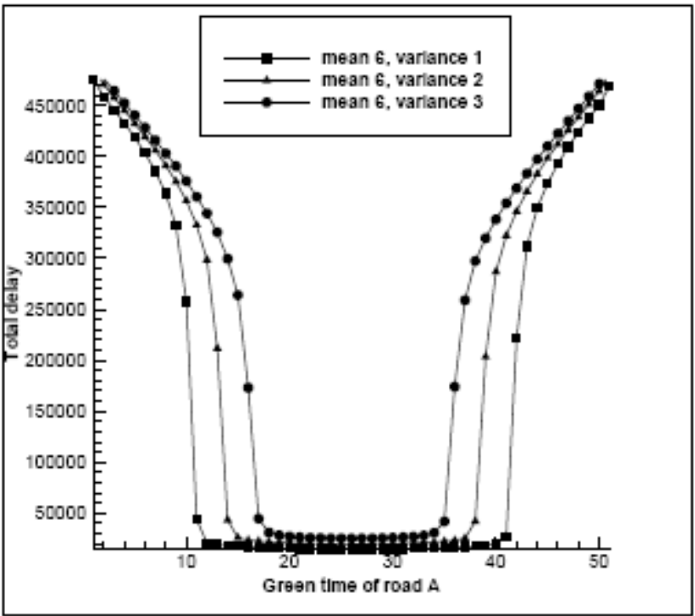
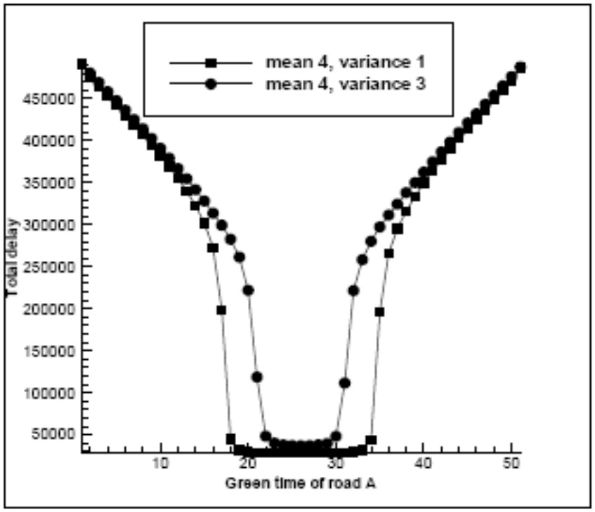
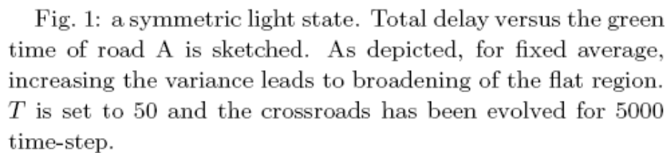
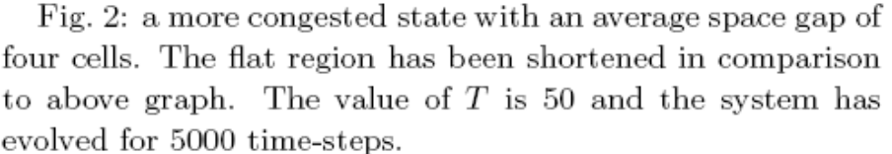
B. symmetric state: light flow

Slide 14
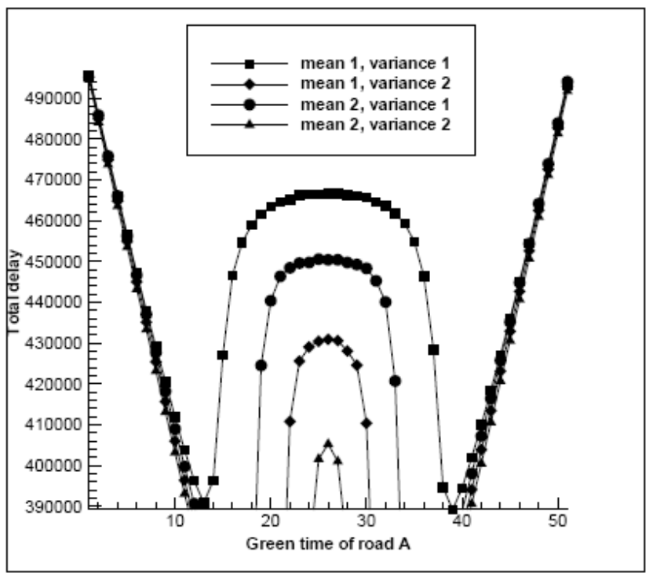
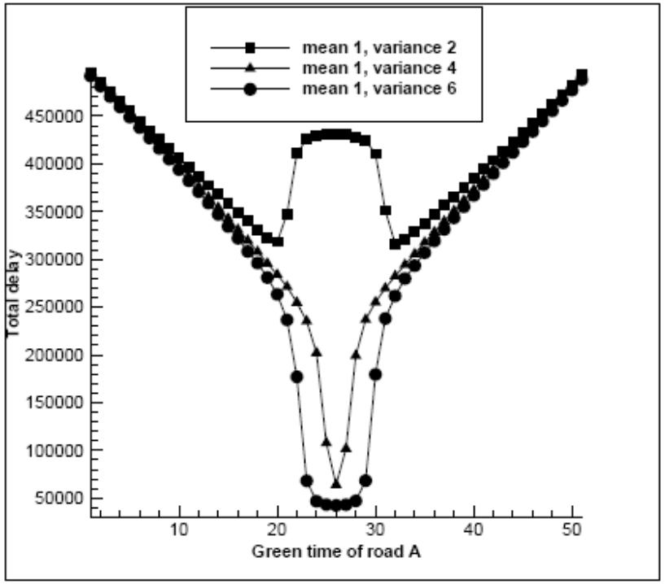
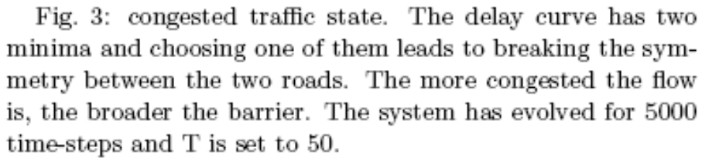
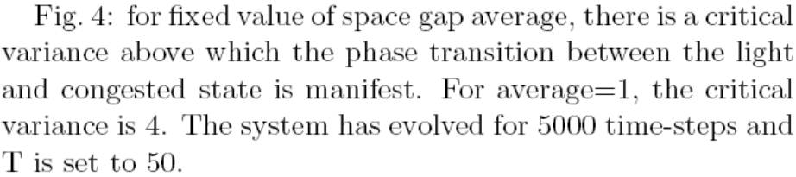
C. congested flow : symmetry broken phase

Slide 15
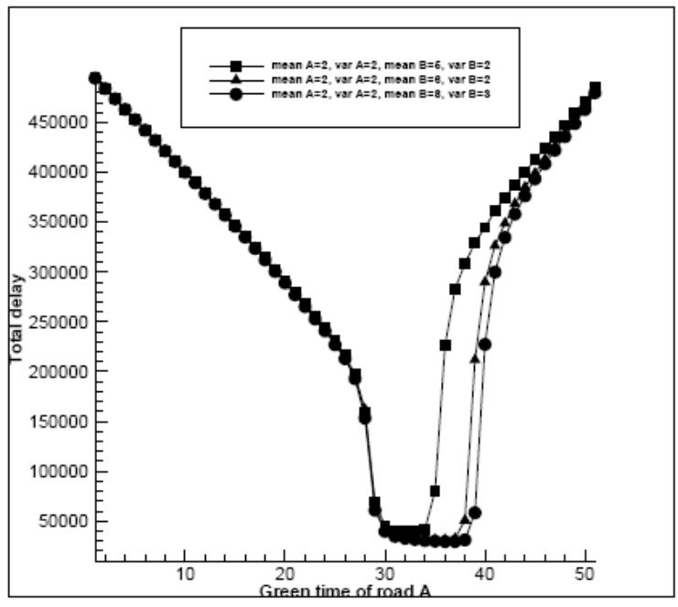
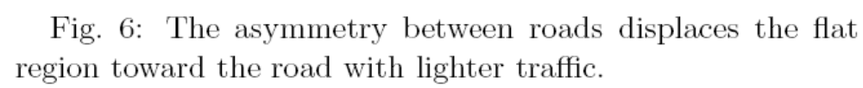
D. Asymmetric case
In cases where both roads are carrying light flows, the asymmetry between entering rates causes a displacement on the position of flat optimum region but does not change the overall characteristics of the delay curve.
An interesting asymmetric state is the
intersection of a major to a minor street.

Slide 16
IV. ONE-WAY TO TWO-WAY CROSSROADS
The simulation rules are the same as one-way to one-way rules.
The total delay is a function of T, T₁, T₂ as well as inflow rates.
traffic is controlled by a fixed-cycle
scheme.
Cycle: T
0 ~ T₁ ~ T₂ ~ T
Street B
g
g
g
Street A

